Slide 1


S.2014.6933576.z
Travelling Salesman Problem using Dynamic Programming and Nearest Neighbor
Guidance & Evaluation by Prof. Kazi Islam
C. Ye, Z. Yang and T. Yan, "An efficient and scalable algorithm for the traveling salesman problem," 2014 IEEE 5th International Conference on Software Engineering and Service Science, Beijing, China, 2014, pp. 335-339, doi: 10.1109/ICSESS.2014.6933576.z

Slide 2
Team Member | Roles and Responsibilities
Aditi Patil | Conducted comprehensive performance evaluation of 2-opt and nearest neighbor algorithm. Analyzed time and space complexity of both algorithms. Identified area of improvement from the existing solution based on results achieved from testing.
Vinoothna Dudam | Explored optimization techniques to enhance algorithm performance and developed an efficient Nearest Neighbor Algorithm for solving (TSP) and also Optimized execution time by implementing garbage collection management and optimizing distance calculations.
Sai Sanjay Potluri | Implemented the 2-opt optimization algorithm to solve the Traveling Salesman Problem (TSP). The code reads a dataset of cities and their geographic coordinates, calculates the total distance of a tour using the Haversine formula, and iteratively improves the route by swapping city pairs for shorter paths. The program outputs the optimized city tour, the total distance traveled, the number of cities in the route, and the execution time.
Chinmayee Krishna Sriramoju | Explored various datasets and created one for this project. Researched different methods for calculating distances involving negative coordinates. Additionally, developed code for distance computation and read the dataset files.
Hema Kanjula | Conducted in-depth research on Dynamic Programming focusing on its advantages and addressing its limitations by integrating the Nearest Neighbor (NN) heuristic. Investigated on 2-opt optimization technique to refine the NN-generated solutions, reducing the overall travel distance and improving efficiency.

Slide 3


Problem Statement
Optimizing the traditional Travelling Salesman Problem’s algorithm using dynamic programming and nearest neighbor. We will take a public dataset containing the geographical coordinates of cities and calculate the shortest distance between all the cities in the TSP dataset. The motivation behind this project stems from the need to enhance the efficiency of traditional TSP algorithms, which are computationally intensive, particularly as the number of cities increases and reduce the shortest distance between them. The goal is to efficiently reduce the computational time required to find the shortest path between all cities, and output the shortest distance as the result.

Slide 4

Introduction

Slide 5

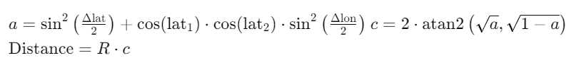
Haversine Distance
Calculates the distance between two points on the surface of a sphere, considering its curvature
Commonly used in navigation, geolocation.
The Haversine formula is expressed as follows:
where,
Δlat and Δlon are the differences in latitudes and longitudes between the two points.
R is the Earth's radius (mean radius ≈ 6371 km).
More accurate distance compared to Euclidean calculations.

Slide 6

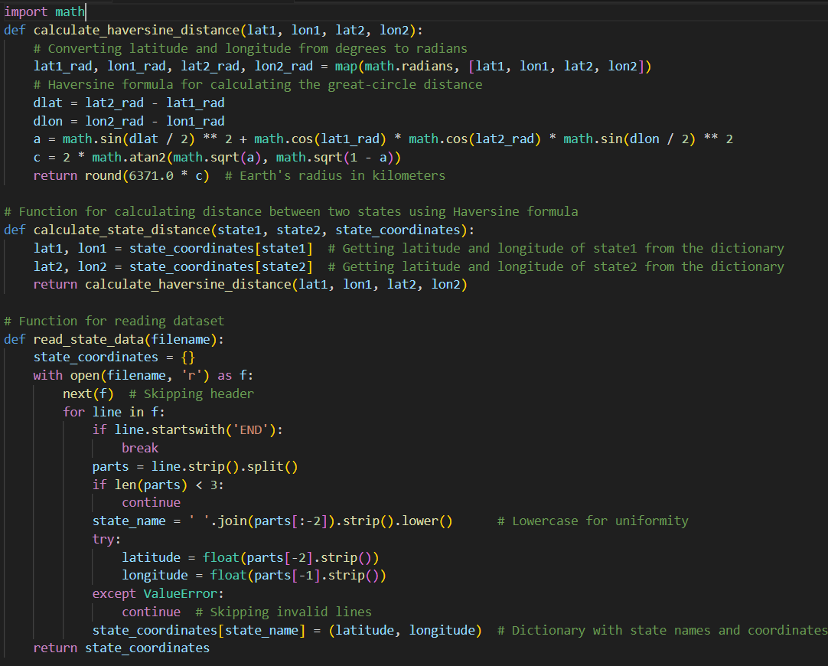
Dataset Description
Contains information about 50 U.S. states
Includes names and geographical coordinates
The dataset was chosen , as it provides the necessary geographical information to compute distances between various locations

Slide 7
Nearest Neighbor
The Nearest Neighbor Algorithm is an opmistic method for solving the Traveling Salesman Problem (TSP). The algorithm works by starting at a random city and repeatedly choosing the closest unvisited city until all cities have been visited. The algorithm then returns to the starting city to complete the tour.
The Nearest Neighbor Algorithm has several advantages, including being memory efficient, requiring minimal memory, and being suitable for environments with limited memory resources.
Additionally, the algorithm has transparent decision-making, is straightforward and easy to understand, and has incremental update capability, allowing it to adopt changes without requiring a complete re-run. The Nearest Neighbor Algorithm is a greedy algorithm, making the locally optimal choice at each step with the intent of finding the overall optimal solution.

Slide 8
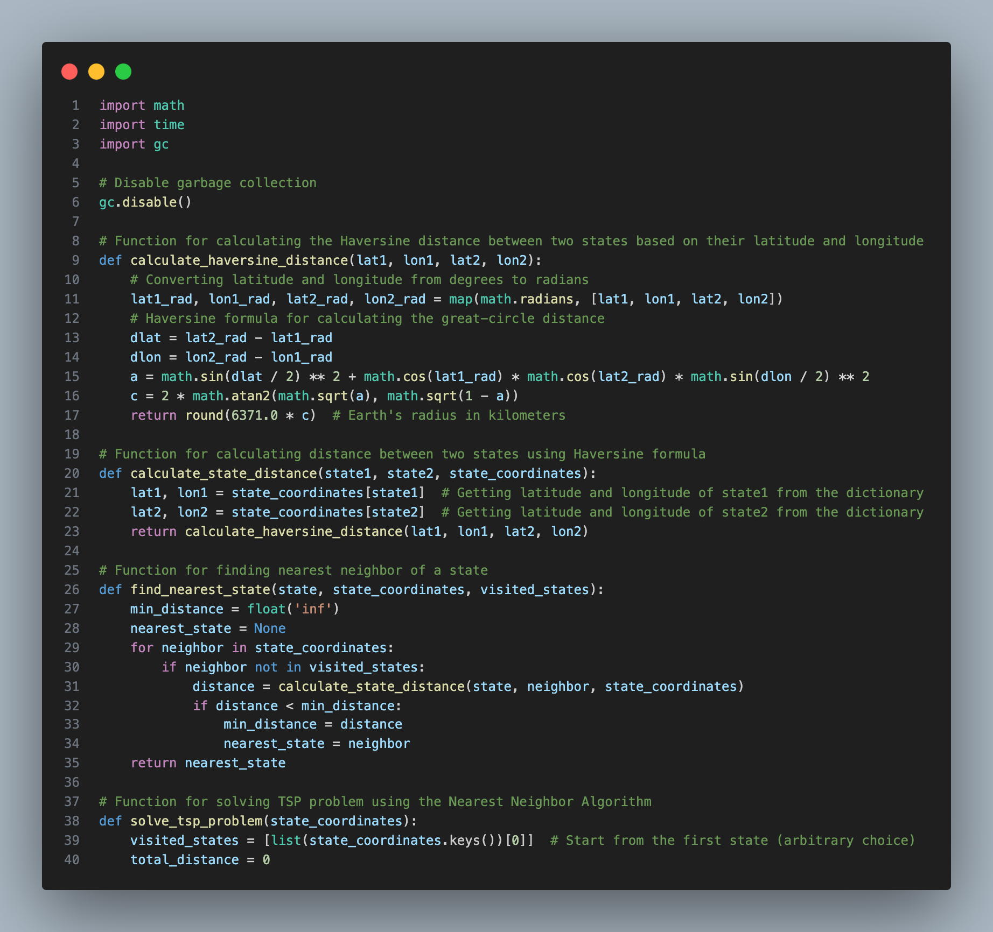
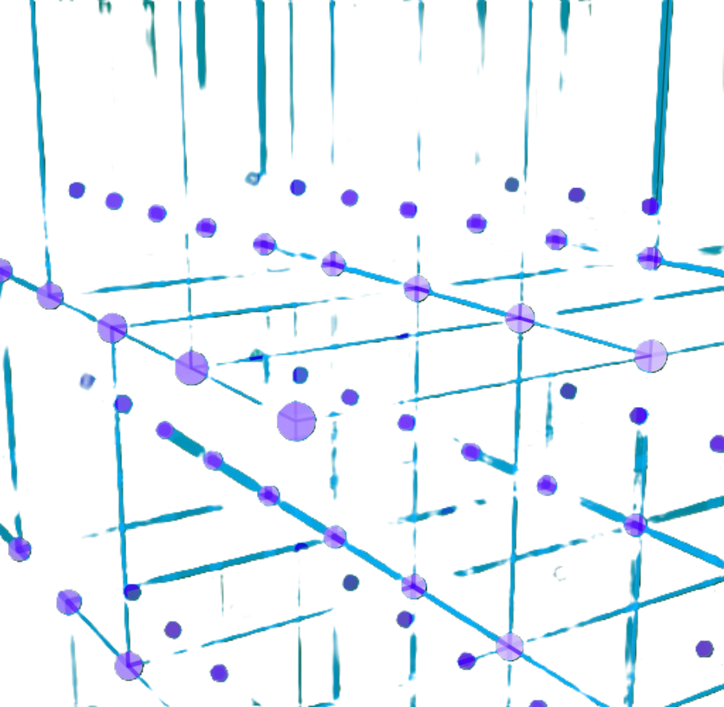
Nearest Neighbor Code

Slide 9
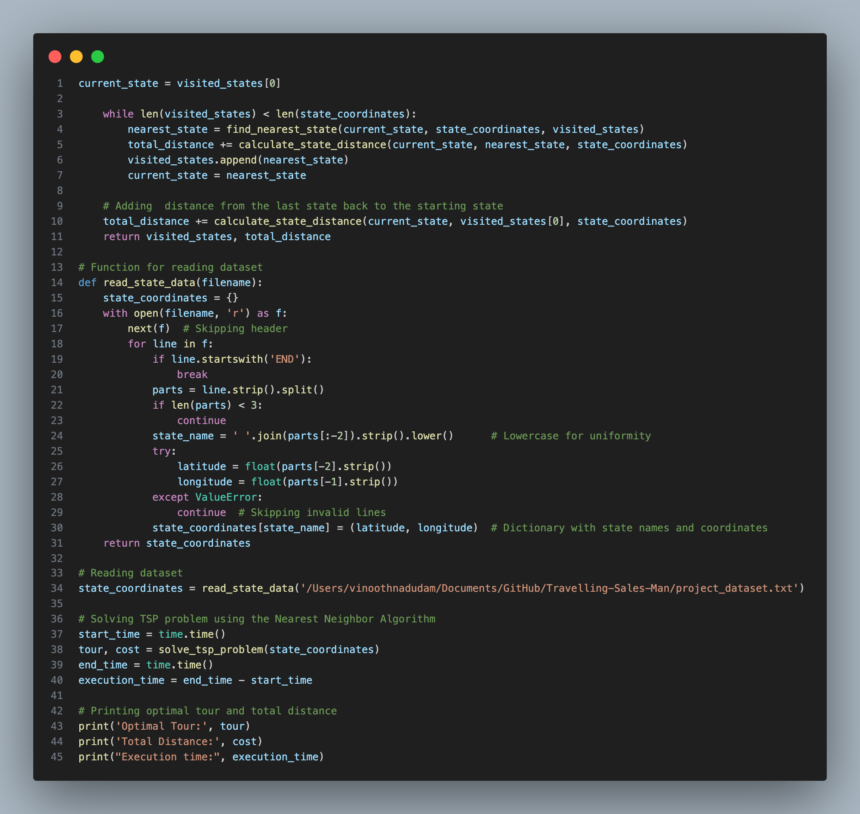
Nearest Neighbor Code

Slide 10
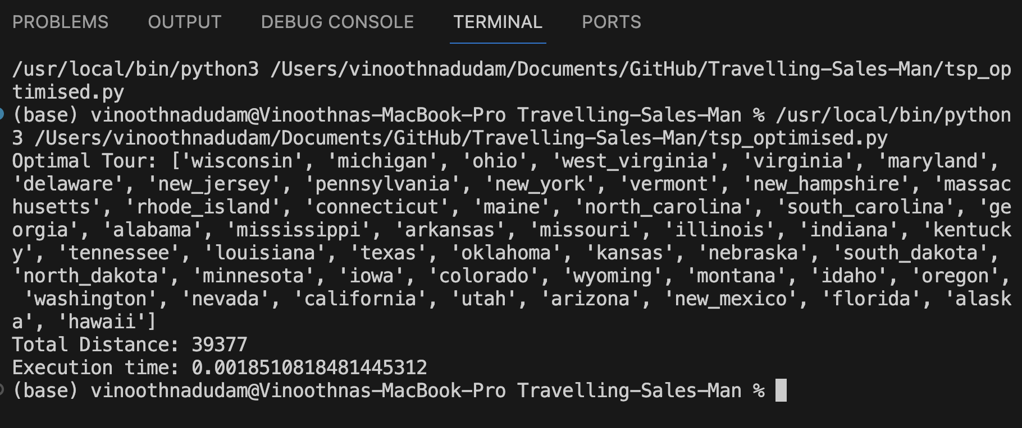
Outputs and Implementation

Slide 11
Implementation Link
https://youtu.be/3g5NBeupuKg

Slide 12

2-Opt Optimisation Algorithm
The 2-opt algorithm is a local optimization technique often used to improve a TSP solution obtained by a heuristic like Nearest Neighbor. It works by:
Selecting two edges in the current tour.
Reversing the order of the nodes between those two edges to see if the new tour is shorter.
Repeating this process until no further improvements can be made.
Incorporating 2-opt into the solution, would involve adding a separate step after generating the initial tour with the Nearest Neighbor Algorithm to check and swap edges for potential improvements.

Slide 13

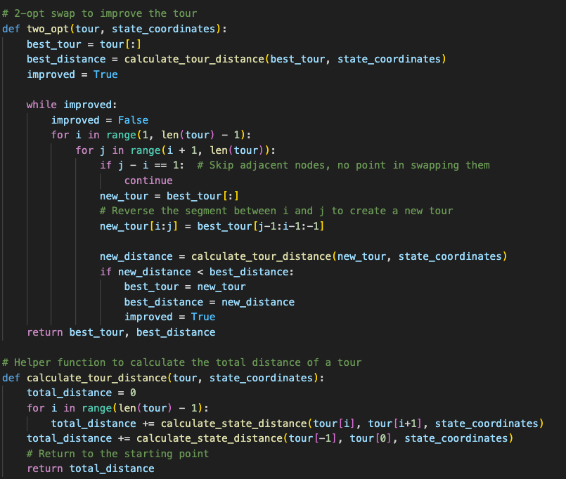
2-Opt Optimisation
Steps:
Initial Tour with Nearest Neighbor Algorithm: You already have this.
2-opt Optimization:
For each pair of edges in the tour, we check if swapping them reduces the total distance.
If a swap improves the distance, we update the tour.
This process is repeated until no further improvement can be made.

Slide 14

Outputs and Implementation
Optimized output
Optimized tour found: ['wisconsin', 'minnesota', 'south_dakota', 'north_dakota', 'montana', 'washington', 'alaska', 'hawaii', 'california', 'nevada', 'oregon', 'idaho', 'utah', 'arizona', 'new_mexico', 'colorado', 'wyoming', 'nebraska', 'texas', 'oklahoma', 'kansas', 'iowa', 'missouri', 'illinois', 'indiana', 'michigan', 'ohio', 'west_virginia', 'pennsylvania', 'new_york', 'vermont', 'new_hampshire', 'maine', 'massachusetts', 'rhode_island', 'connecticut', 'new_jersey', 'delaware', 'maryland', 'virginia', 'north_carolina', 'south_carolina', 'florida', 'alabama', 'georgia', 'kentucky', 'tennessee', 'arkansas', 'mississippi', 'louisiana’]
Total distance of the optimized tour: 32409
Execution time: 1.4761557579040527

Slide 15
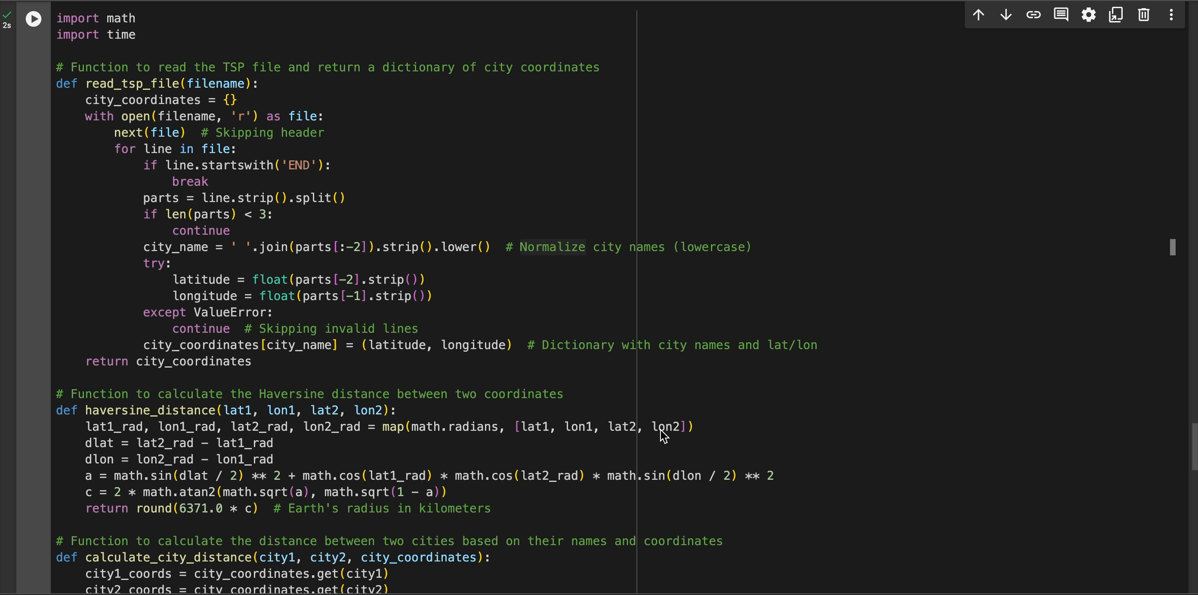
Outputs and Implementation
Implementation

Slide 16

Progress Report
Current Progress:
Successfully developed Nearest Neighbor and 2-opt algorithms
Tested on dataset of the geographical locations showing promising results
Comprehensive performance evaluation conducted on dataset
Achieved good performance but requires further improvement in terms of time complexity and overall efficiency
Identified areas for improvement in terms of time and space efficiency

Slide 17
Performance Evaluation
Time and Space Complexity:
Algorithm | Best Time Complexity | Worst Time Complexity | Average Time Complexity | Space Complexity
Nearest Neighbor | O(n²) | O(n²) | O(n²) | O(n)
2-opt | O(n²) | O(n³) | O(n³) | O(n)

Slide 18

Prognosis and Future Work
Investigate advanced techniques to reduce time and space complexity
Implement Dynamic programming solution to solve TSP (Travelling Salesman Problem)
Optimize Dynamic programming solution if required
Analyze complexity and test Dynamic programming solution with small to medium size dataset
Compare Dynamic programming solution with nearest neighbor and 2-opt solution
Identify strengths and weaknesses of each algorithmic solution
Implement necessary final adjustments based on testing feedback
Write comprehensive documentation

Slide 19

References
Y. Wang, "A Nearest Neighbor Method with a Frequency Graph for Traveling Salesman Problem," 2014 Sixth International Conference on Intelligent Human-Machine Systems and Cybernetics, Hangzhou, China, 2014, pp. 335-338, doi: 10.1109/IHMSC.2014.88.
D.S. Johnson and L.A. McGeoch, “The Traveling Salesman Problem: A Case Study in Local Optimization”, November 20, 1995.
F. Nuriyeva, "Heuristic Algorithm for Solving Travelling Salesman Problem: Adding the Endpoints of the Longest Edges," 2023 5th International Conference on Problems of Cybernetics and Informatics (PCI), Baku, Azerbaijan, 2023, pp. 1-4, doi: 10.1109/PCI60110.2023.10325958.
E. O. Asani, A. E. Okeyinka and A. A. Adebiyi, "A Construction Tour Technique For Solving The Travelling Salesman Problem Based On Convex Hull And Nearest Neighbour Heuristics," 2020 International Conference in Mathematics, Computer Engineering and Computer Science (ICMCECS), Ayobo, Nigeria, 2020, pp. 1-4, doi: 10.1109/ICMCECS47690.2020.240847.
K. Rocki and R. Suda, "Accelerating 2-opt and 3-opt Local Search Using GPU in the Travelling Salesman Problem," 2012 12th IEEE/ACM International Symposium on Cluster, Cloud and Grid Computing (ccgrid 2012), Ottawa, ON, Canada, 2012, pp. 705-706, doi: 10.1109/CCGrid.2012.133.
I. Mavroidis, I. Papaefstathiou and D. Pnevmatikatos, "Hardware Implementation of 2-Opt Local Search Algorithm for the Traveling Salesman Problem," 18th IEEE/IFIP International Workshop on Rapid System Prototyping (RSP '07), Porto alegre, Brazil, 2007, pp. 41-47, doi: 10.1109/RSP.2007.24.
Y. Zhang, C. Wang, H. Li, X. Su, M. Zhao and N. Zhang, "An Improved 2-Opt and ACO Hybrid Algorithm for TSP," 2018 Eighth International Conference on Instrumentation & Measurement, Computer, Communication and Control (IMCCC), Harbin, China, 2018, pp. 547-552, doi: 10.1109/IMCCC.2018.00121.

Slide 20
THANK YOU

